Slide 1



Introduction to eBook Devices and Formats
Joshua Tallent
Founder/CEO
Copyright © 2010 eBook Architects LLC. All rights Reserved.

Slide 2
Introduction
Who am I?
Who are you?
Purpose of this session:
To give an overview of eBook formatting on the most popular devices and applications, and to give tips on the creation of beautiful
cross-platform eBooks.

Slide 3
eBookArchitects.com/toc.php

Slide 4

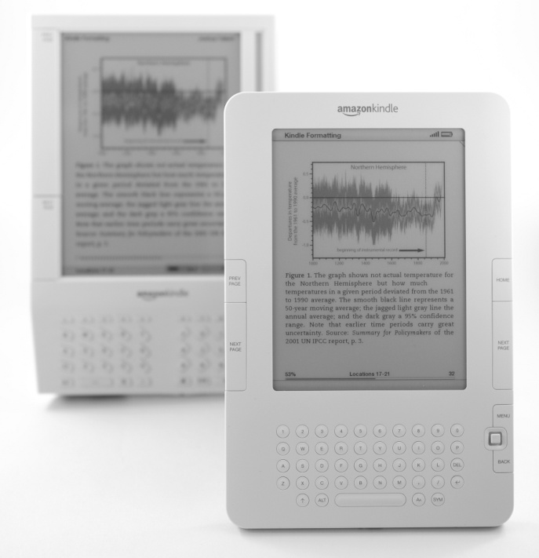








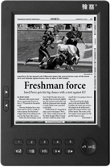
Kindle/Mobipocket Format
Where files can be opened:
Blackberry
Windows Mobile
Symbian
Palm
BeBook
Bookeen Cybook
Hanlin
iRex

Slide 5
Kindle eBook Construction
Kindle eBooks are formatted in HTML 3-ish, a little bit of CSS, and some proprietary code
Formatting Kindle books in Word or other formats will cause problems
There is a little bit of consistency due to restricted platforms, but watch out for non-device versions
To build a Kindle eBook, use Mobipocket Creator or KindleGen.

Slide 6
Kindle Best Practices
Keep it simple
Develop a template
Images: 520px wide by 610px high, <64kb
Insert tables as images
<blockquote> tags should have no <p> tags inside

Slide 7



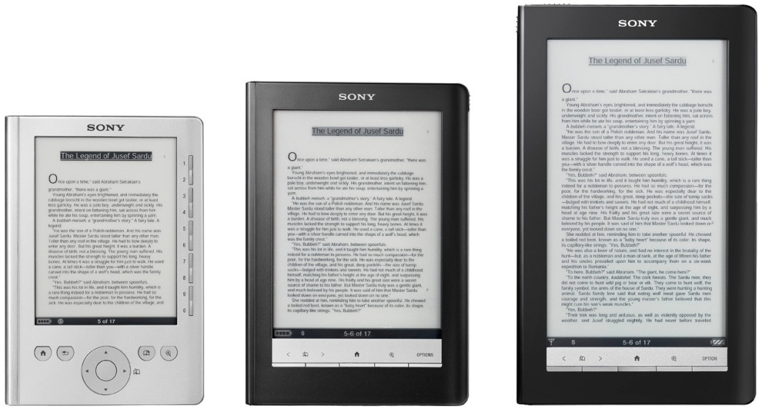

ePub Format
Where files can be opened:

Slide 8
















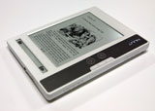

ePub Format
tinyurl.com/ePubDevices

Slide 9
ePub eBook Construction
Zip file with a “*.epub” extension
Internal files are XHTML, CSS, and some XML
Can be read on a large number of devices
Interoperability requires minimizing advanced formatting

Slide 10
ePub Best Practices
Get familiar with the format
Build a template
Stick to formatting that works on the broadest range of devices
For devices you have control over (iPad?) make things more interesting

Slide 11
Formatting Samples

Slide 12
Cryptic ePub Error #1
“I/O error reading toc.ncx”
Your NCX file has Unicode characters in it

Slide 13
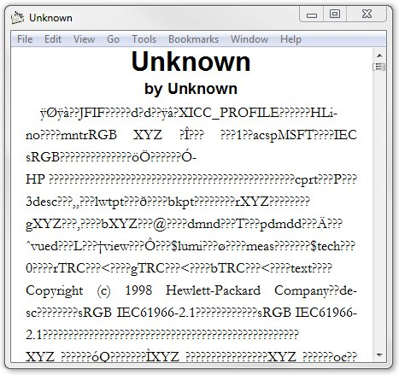
Cryptic ePub Error #2
In Stanza for the Desktop
Your OPF file is saved as a Unicode file, not as ASCII

Slide 14
Kindle Resources
Kindle Formatting: The Complete Guide
kindleformatting.com/book
Mobipocket Creator
tinyurl.com/mpcreator
KindleGen
tinyurl.com/kindlegen
Kindle for PC
www.amazon.com/KindleForPC

Slide 15
ePub Resources
International Digital Publishing Forum
IDPF.org
Adobe MAX session on InDesign to ePub:
tinyurl.com/ePubMAX
Adobe Digital Editions:
adobe.com/products/digitaleditions
Adobe Guide to ePub Best Practices
tinyurl.com/ePubBest

Slide 16
ePub Resources
List of devices with Adobe SDK
tinyurl.com/ePubDevices
EPUB Math: Best Practices for Mathematics
tinyurl.com/ePubMath1
Sample ePub with Math Equations in SVG
tinyurl.com/ePubMath2
Page Numbers in NCX (NOT OFFICIAL)
tinyurl.com/ePubNCXPages

Slide 17
ePub Tools
Sigil (code.google.com/p/sigil)
eCub (juliansmart.com/ecub)
ePub Tools (code.google.com/p/epub-tools)
ePubCheck (code.google.com/p/epubcheck)
ePubCheck online (threepress.org/document/epub-validate)
calibre (calibre.kovidgoyal.net)

Slide 18
Q & A

Slide 19
Joshua Tallent
joshua@ebookarchitects.com
512-939-3466
www.ebookarchitects.com
www.kindleformatting.com
@jtallent
@ebookarchitects

